Slide 1
Gaming console network analysis
Ethan Dark
APRD6343
April 1, 2021

Slide 2
Agenda
Network Analysis Definition
Preprocessing Overview
Mention Network Analysis
Semantic Network Analysis

Slide 3
Network Analysis Definition
Primary use
Nodes and edges
Social analysis
Semantic analysis
Centrality

Slide 4
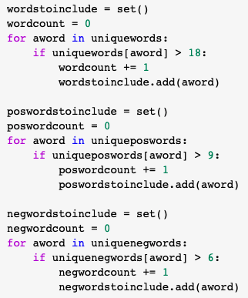
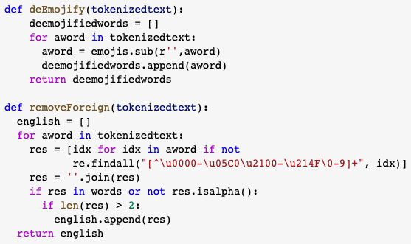
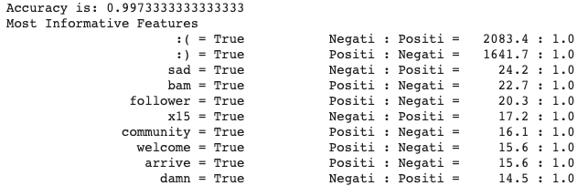
Preprocessing Overview

Slide 5
Mention Network Analysis

Slide 6
Semantic Network Analysis

Slide 7
Semantic Network Analysis with Positive Sentiment

Slide 8
Semantic Network Analysis with Negative Sentiment

